Slide 1
Semi-automated Segmentation Pipeline for Analysis of Knee Joint Kinematics
Wissenschaftliches Werner Kaiser-Sommersymposium
AG Med Phys
A comparision with manual based segmentation
Jena | 12.09.2024 | Aayush Nepal

Slide 2
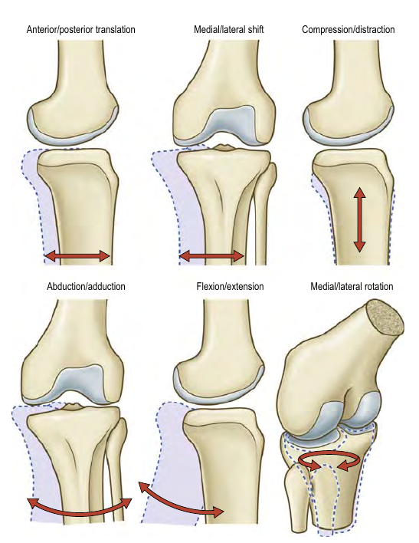
Motivation
Six Degrees of freedom
3 Rotations
Flexion-Extension: 5° hyperextension to 160° flexion
Medial-Lateral:
(Credit: Gray’s Anatomy 42nd ed.)
Notes:
If we can quantify any one of these motions accurately, then vital information might be revealed.

Slide 6
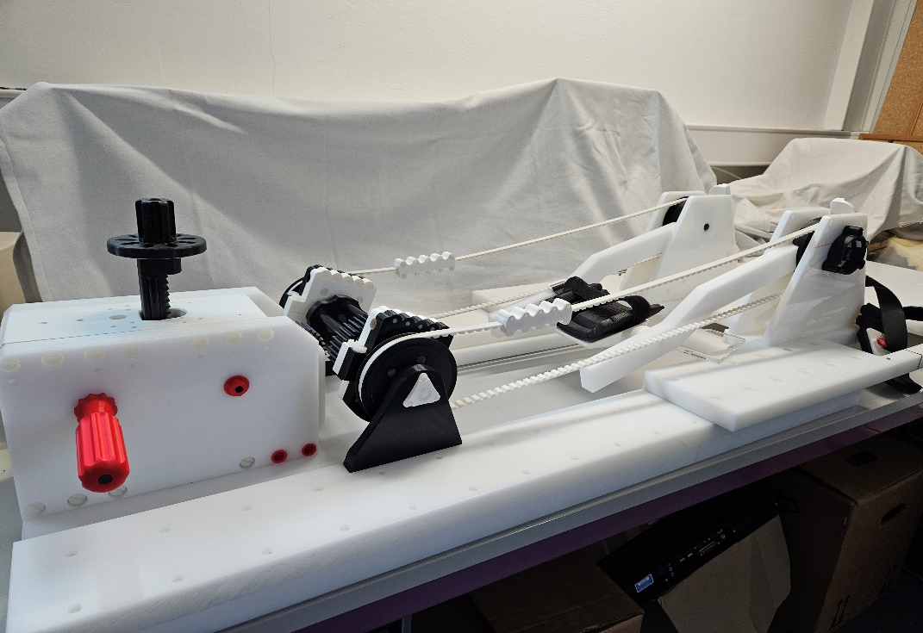
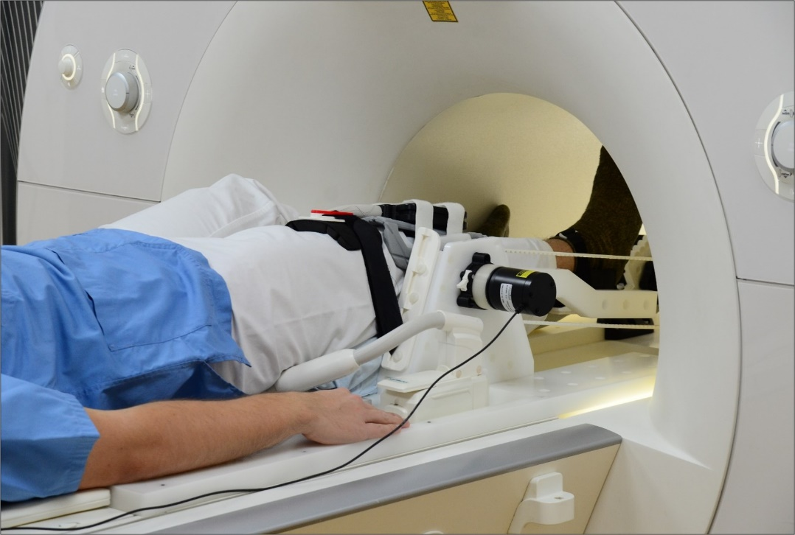
Knee flexion-extension device

Slide 7
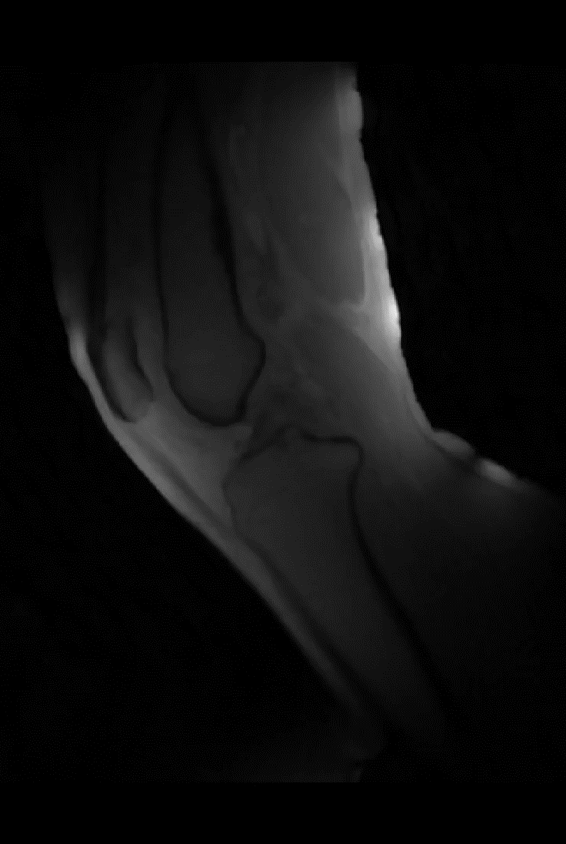
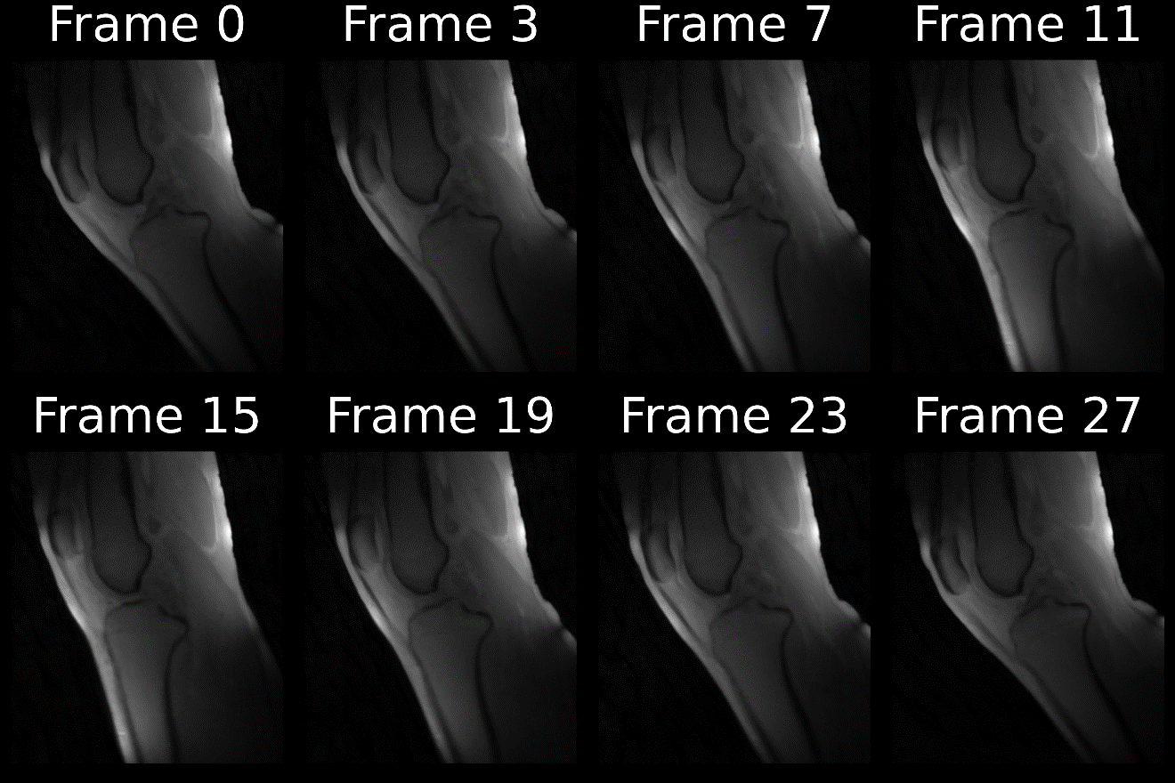
Reconstructed frames

Slide 8
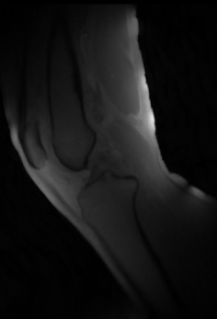
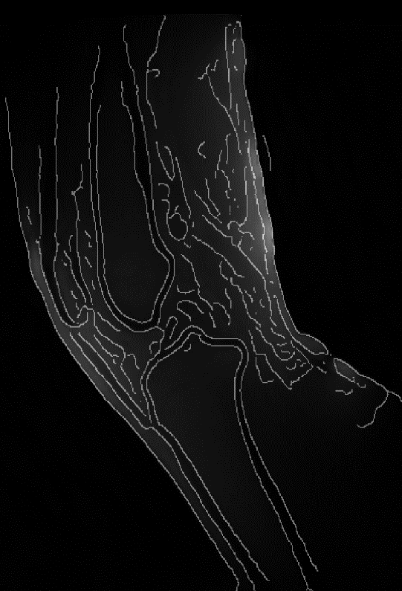
Methods

Slide 9
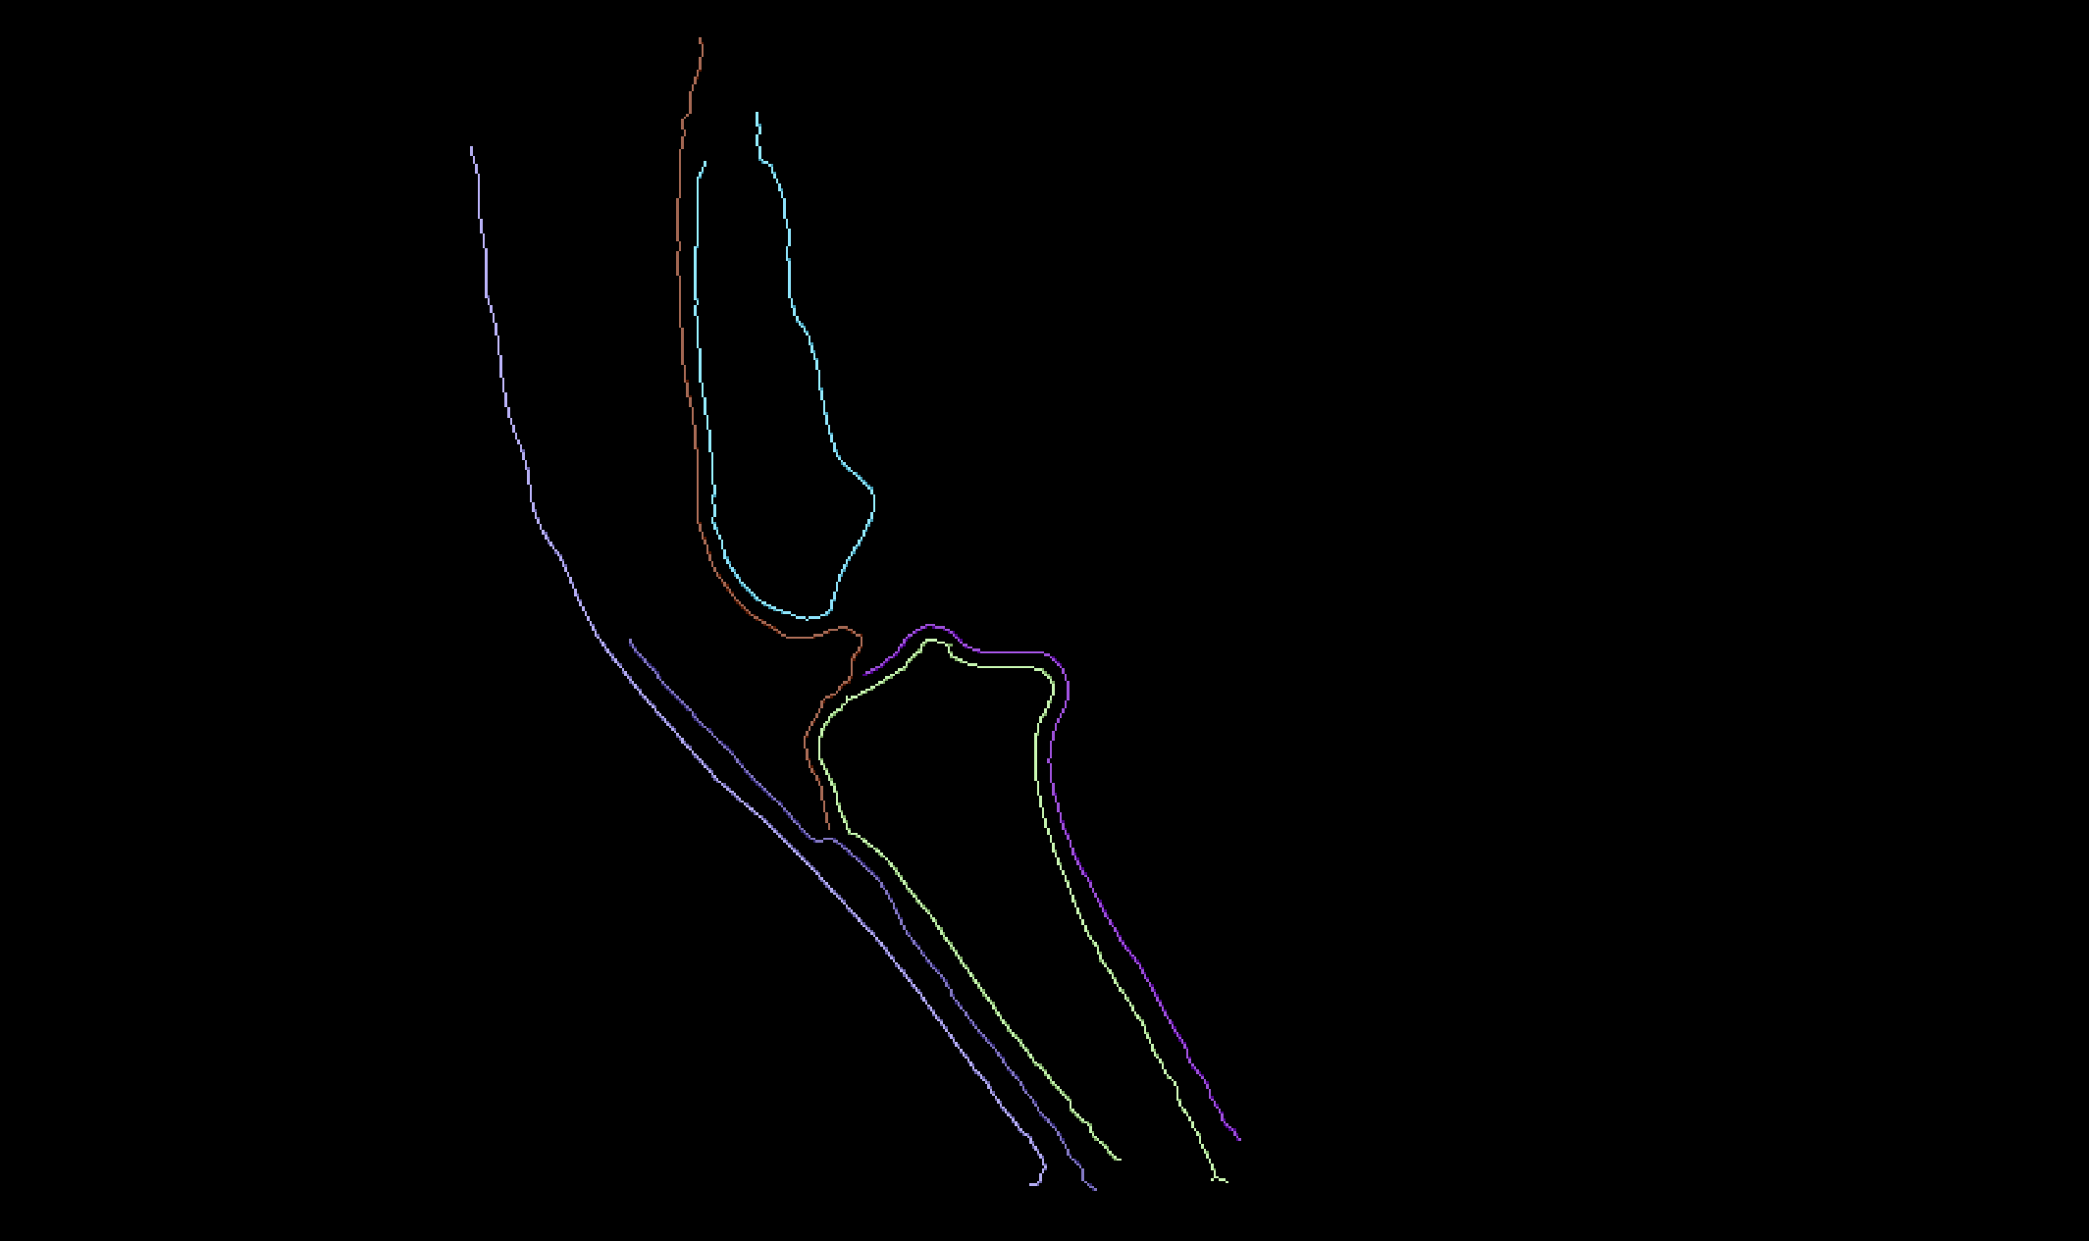
Methods

Slide 10
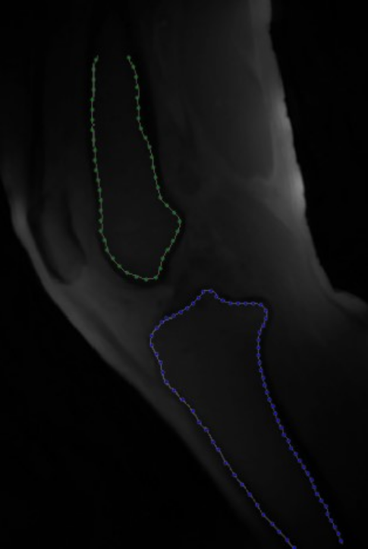
Methods

Slide 11
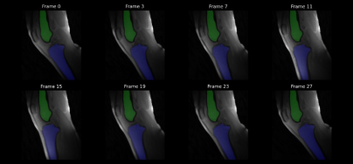
Methods

Slide 12
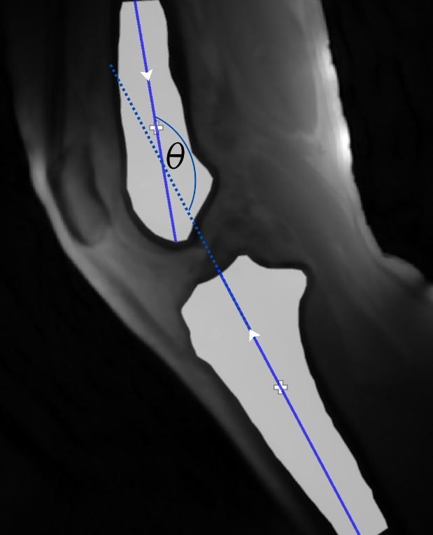
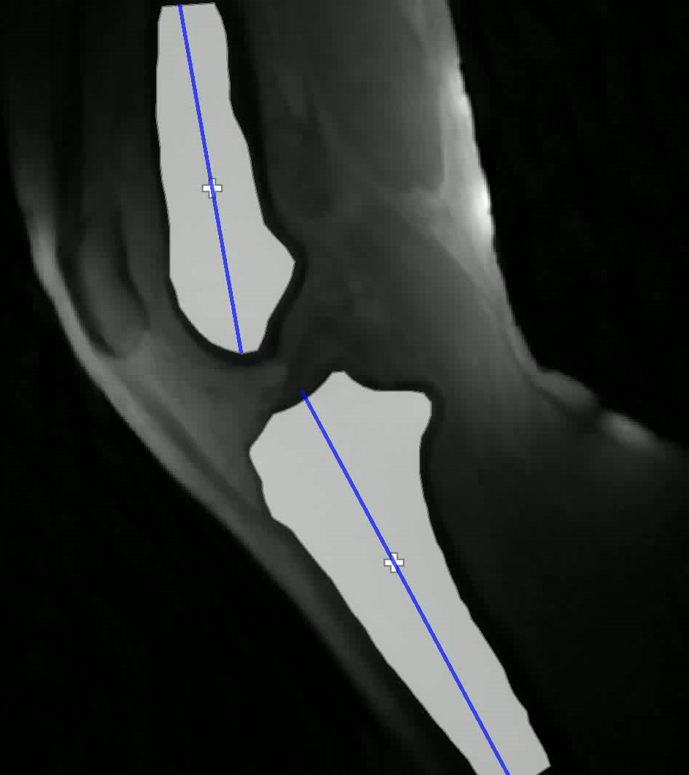
Angle extraction and tracking

Slide 13
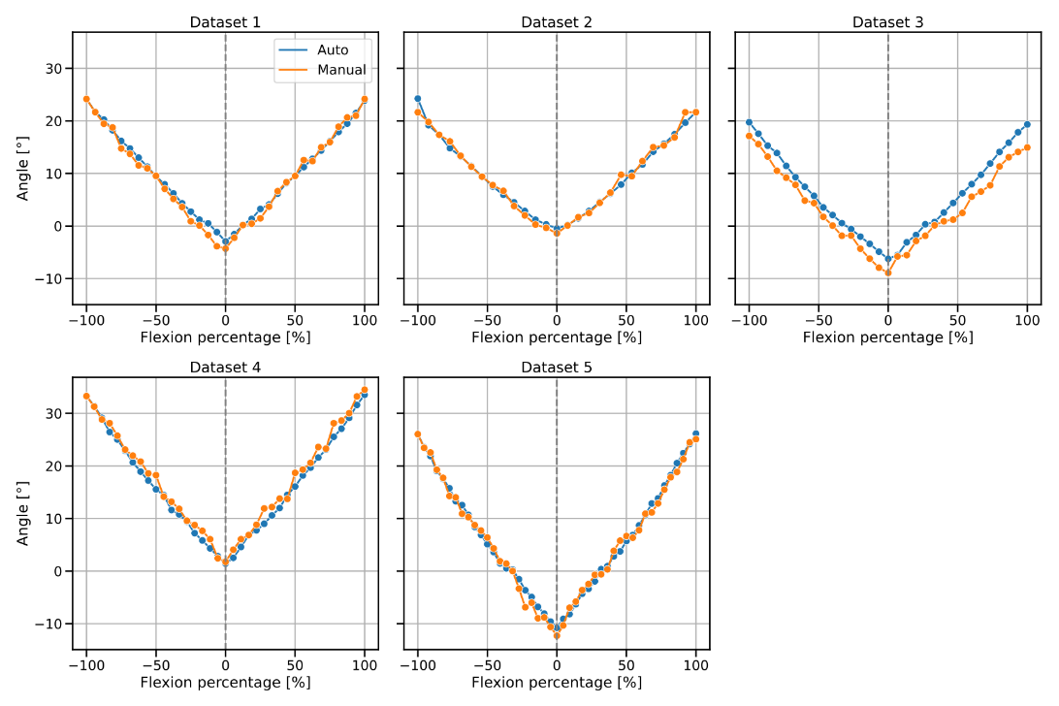
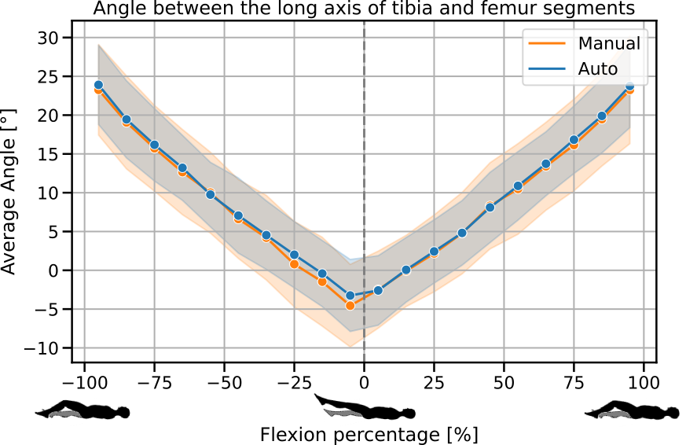
Results

Slide 14
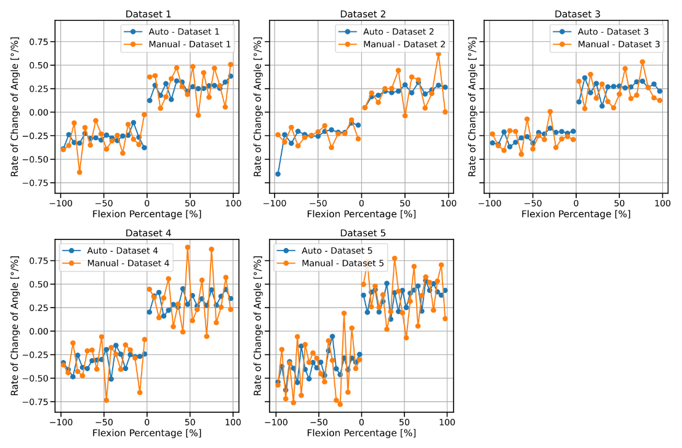
Results

Slide 15
Concluding Remarks

